Slide 1
Time Integration A to Z
김주현

Slide 2
Contents
Time Integration Schemes
Starting procedure
Formulation of Residual Terms
PETSc manual
Interface with PETSc
What need to be modified?

Slide 3
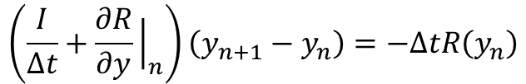


Time Integration Schemes
Backward Differentiation Formulae(BDF)
BDF1(Implicit Euler)
BDF2
$$y_{n+1}−y_{n}=−∆tR\left(y_{n+1}\right)$$
$$\left(\frac{I}{∆t}+\frac{∂R}{∂y}{\left.​\right|}_{n}\right)\left(y_{n+1}−y_{n}\right)=−∆tR\left(y_{n}\right)$$
$$y_{n+1}−\frac{4}{3}y_{n}+\frac{1}{3}y_{n−1}=−\frac{2∆t}{3}R\left(y_{n+1}\right)$$
$$\left(\frac{3I}{2∆t}+\frac{∂R}{∂y}{\left.​\right|}_{(i)}\right)\left(y_{n+1}^{\left(i+1\right)}−y_{n+1}^{\left(i\right)}\right)=−\frac{2∆t}{3}R\left(y_{n+1}^{\left(i\right)}\right)−y_{n+1}^{\left(i\right)}+\frac{4}{3}y_{n}−\frac{1}{3}y_{n+1}$$

Slide 4
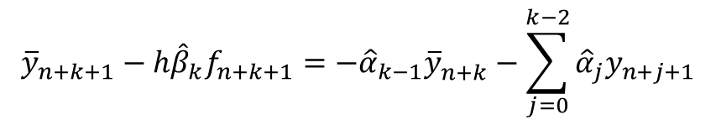
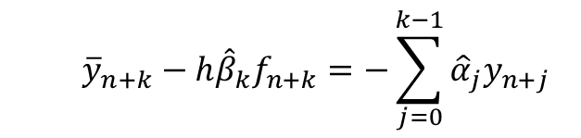

Time Integration Schemes
Modified Extended BDF(MEBDF)
Order k+1
$${\overline{y}}_{n+k}−h{\hat{β}}_{k}f_{n+k}=−\sum_{j=0}^{k−1}{{\hat{α}}_{j}y_{n+j}}$$
$${\overline{y}}_{n+k+1}−h{\hat{β}}_{k}f_{n+k+1}=−{\hat{α}}_{k−1}{\overline{y}}_{n+k}^{ }−\sum_{j=0}^{k−2}{{\hat{α}}_{j}y_{n+j+1}}$$
$$y_{n+k}−h{\hat{β}}_{k}f_{n+k}−h\left(β_{k}−{\hat{β}}_{k}\right){\overline{f}}_{n+k}=−\sum_{j=0}^{k−1}{α_{j}y_{n+j}}+hβ_{k+1}{\overline{f}}_{n+k+1}$$

Slide 5
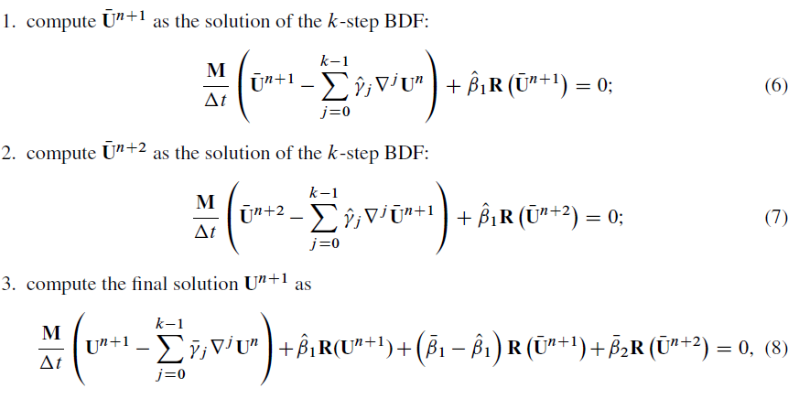
Time Integration Schemes
Modified Extended BDF(MEBDF)
Order k+1

Slide 6

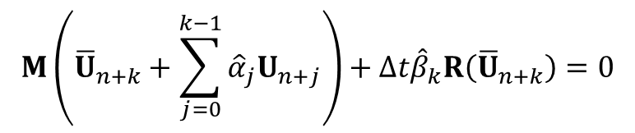
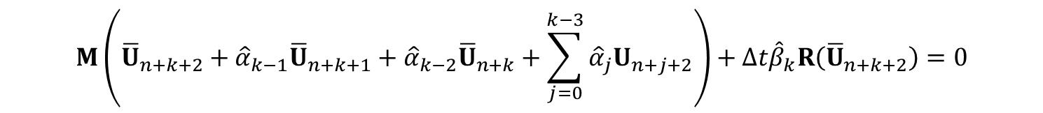
Time Integration Schemes
Two Implicit Advanced Step-point(TIAS)
Order k+1
$$M\left({\overline{U}}_{n+k}+\sum_{j=0}^{k−1}{{\hat{α}}_{j}U_{n+j}}\right)+∆t{\hat{β}}_{k}R\left({\overline{U}}_{n+k}\right)=0$$
$$M\left({\overline{U}}_{n+k+1}+{\hat{α}}_{k−1}{\overline{U}}_{n+k}+\sum_{j=0}^{k−2}{{\hat{α}}_{j}U_{n+j+1}}\right)+∆t{\hat{β}}_{k}R\left({\overline{U}}_{n+k+1}\right)=0$$
$$M\left({\overline{U}}_{n+k+2}+{\hat{α}}_{k−1}{\overline{U}}_{n+k+1}+{\hat{α}}_{k−2}{\overline{U}}_{n+k}+\sum_{j=0}^{k−3}{{\hat{α}}_{j}U_{n+j+2}}\right)+∆t{\hat{β}}_{k}R\left({\overline{U}}_{n+k+2}\right)=0$$
$$M\left(U_{n+k}+\sum_{j=0}^{k−1}{{\tilde{α}}_{j}U_{n+j}}\right)+∆t\left[{\tilde{β}}_{k+2}R\left({\overline{U}}_{n+k+2}\right)+{\tilde{β}}_{k+1}R\left({\overline{U}}_{n+k+1}\right)+β_{k}R\left({\overline{U}}_{n+k}\right)+\left({\tilde{β}}_{k}−β_{k}\right)R\left(U_{n+k}\right)\right]=0$$

Slide 7
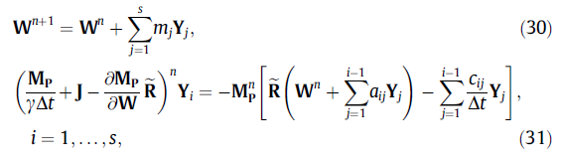

Time Integration Schemes
Rosenbrock method

Slide 8




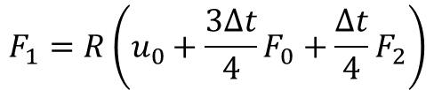


Time Integration Schemes
Self-starting Procedure
For example, time order = 4
$$u_{0}=u\left(x,t_{0}\right)$$
$$F_{0}=R\left(u_{0}\right)$$
$$F_{2}=R\left(u_{0}+2∆tF_{0}\right)$$
$$F_{1}=R\left(u_{0}+\frac{3∆t}{4}F_{0}+\frac{∆t}{4}F_{2}\right)$$
$$F_{2}=R\left(u_{0}+∆tF_{0}+∆tF_{2}\right)$$
$$u_{1}=u_{0}+\frac{5∆t}{12}F_{0}+\frac{2∆t}{3}F_{1}−\frac{∆t}{12}F_{2}$$
$$u_{1}=u_{0}+\frac{∆t}{3}F_{0}+\frac{4∆t}{3}F_{1}+\frac{∆t}{3}F_{2}$$

Slide 9









Formulation of Residual Terms
Block matrix(Mth row, N^{th} column)
$$u(Ω)=u\left[icell\right]\left[istate\right][ibasis]$$
$$\frac{∂R_{M}}{∂u_{M}}$$
$$\frac{∂R_{M}}{∂u_{N}}$$
$$Ω_{M}$$
$$Ω_{M}$$
$$Ω_{N}$$
$$\frac{∂R_{N}}{∂u_{M}}$$
$$\frac{∂R_{N}}{∂u_{N}}$$
$$Ω_{N}$$

Slide 10





Formulation of Residual Terms
For block matrix(M,N)
Block matrix(state s, state t)
$$\frac{∂(state s)}{∂(state s)}$$
$$\frac{∂(state s)}{∂(state t)}$$
State
s
$$\frac{∂R_{M}}{∂u_{N}}$$
$$\frac{∂(state t)}{∂(state s)}$$
$$\frac{∂(state t)}{∂(state t)}$$
State
t

Slide 11





Formulation of Residual Terms
For block matrix(state s, state t)
Scalar
$$\frac{∂(basis p)}{∂(basis p)}$$
$$\frac{∂(basis p)}{∂(basis q)}$$
Basis
p
$$\frac{∂(state s)}{∂(state t)}$$
$$\frac{∂(basis q)}{∂(basis p)}$$
$$\frac{∂(basis q)}{∂(basis q)}$$
Basis
q

Slide 12






Formulation of Residual Terms
Nomenclature
$$F=F_{c}−F_{v}$$
physical flux
$$F^{∗}=F_{c}^{∗}−F_{v}^{∗}$$
numerical flux
$$u_{−}=\sum_{i=0}^{k}{u_{−}^{(i)}φ_{−}^{\left(i\right)}}$$
owner cell variable
$$u_{−}^{DOF}=\left(u_{−}^{\left(0\right)},u_{−}^{\left(1\right)} ,⋯,u_{−}^{\left(k\right)}\right)$$
owner cell DOFs
$$u_{+}=\sum_{i=0}^{k}{u_{+}^{(i)}φ_{+}^{\left(i\right)}}$$
neighbor cell variable
$$u_{+}^{DOF}=\left(u_{+}^{\left(0\right)},u_{+}^{\left(1\right)} ,⋯,u_{+}^{\left(k\right)}\right)$$
neighbor cell DOFs

Slide 13

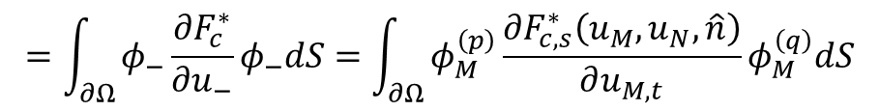

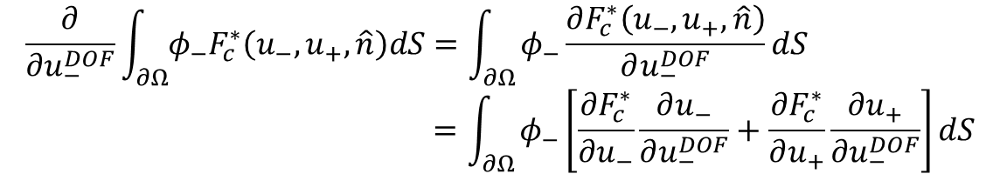




Formulation of Residual Terms
$$u_{−}=\sum_{i=0}^{k}{u_{−}^{(i)}φ_{−}^{\left(i\right)}}$$
$$u_{−}^{DOF}=\left(u_{−}^{\left(0\right)},u_{−}^{\left(1\right)} ,⋯,u_{−}^{\left(k\right)}\right)$$
$$u_{+}=\sum_{i=0}^{k}{u_{+}^{(i)}φ_{+}^{\left(i\right)}}$$
Convective Flux
Face integral of owner cell
w.r.t. owner cell
$$u_{+}^{DOF}=\left(u_{+}^{\left(0\right)},u_{+}^{\left(1\right)} ,⋯,u_{+}^{\left(k\right)}\right)$$
$$\frac{∂}{∂u_{−}^{DOF}}\int_{∂Ω}{φ_{−}F_{c}^{∗}\left(u_{−},u_{+},\hat{n}\right)dS}=\int_{∂Ω}{φ_{−}\frac{∂F_{c}^{∗}\left(u_{−},u_{+},\hat{n}\right)}{∂u_{−}^{DOF}}dS} \\ =\int_{∂Ω}{φ_{−}\left[\frac{∂F_{c}^{∗}}{∂u_{−}}\frac{∂u_{−}}{∂u_{−}^{DOF}}+\frac{∂F_{c}^{∗}}{∂u_{+}}\frac{∂u_{+}}{∂u_{−}^{DOF}}\right]dS}$$
$$φ_{−}$$
$$0$$
$$=\int_{∂Ω}{φ_{−}\frac{∂F_{c}^{∗}}{∂u_{−}}φ_{−}dS}=\int_{∂Ω}{φ_{M}^{\left(p\right)}\frac{∂F_{c,s}^{∗}\left(u_{M},u_{N},\hat{n}\right)}{∂u_{M,t}}φ_{M}^{\left(q\right)}dS}$$
①
②
③
①
face_owner_coefficients [iface][ipoint][ibasis]
②
conv_flux_owner_jacobian [ipoint][istate][jstate]
③
face_owner_basis_value [iface][ipoint][jbasis]

Slide 14
Formulation of Residual Terms
$$u_{−}=\sum_{i=0}^{k}{u_{−}^{(i)}φ_{−}^{\left(i\right)}}$$
$$u_{−}^{DOF}=\left(u_{−}^{\left(0\right)},u_{−}^{\left(1\right)} ,⋯,u_{−}^{\left(k\right)}\right)$$
$$u_{+}=\sum_{i=0}^{k}{u_{+}^{(i)}φ_{+}^{\left(i\right)}}$$
Convective Flux
Face integral of owner cell
w.r.t. neighbor cell
$$u_{+}^{DOF}=\left(u_{+}^{\left(0\right)},u_{+}^{\left(1\right)} ,⋯,u_{+}^{\left(k\right)}\right)$$
$$\frac{∂}{∂u_{+}^{DOF}}\int_{∂Ω}{φ_{−}F_{c}^{∗}\left(u_{−},u_{+},\hat{n}\right)dS}=\int_{∂Ω}{φ_{−}\frac{∂F_{c}^{∗}}{∂u_{+}}φ_{+}dS}=\int_{∂Ω}{φ_{M}^{\left(p\right)}\frac{∂F_{c,s}^{∗}\left(u_{M},u_{N},\hat{n}\right)}{∂u_{N,t}}φ_{N}^{\left(q\right)}dS}$$
①
②
③
①
face_owner_coefficients [iface][ipoint][ibasis]
②
conv_flux_neighbor_jacobian [ipoint][istate][jstate]
③
face_neighbor_basis_value [iface][ipoint][jbasis]

Slide 15
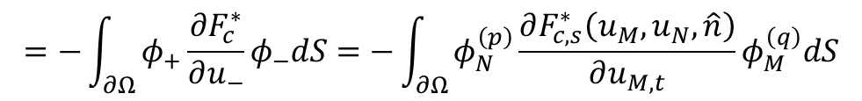
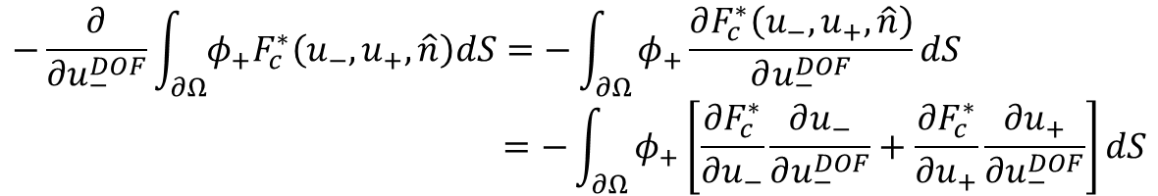
Formulation of Residual Terms
$$u_{−}=\sum_{i=0}^{k}{u_{−}^{(i)}φ_{−}^{\left(i\right)}}$$
$$u_{−}^{DOF}=\left(u_{−}^{\left(0\right)},u_{−}^{\left(1\right)} ,⋯,u_{−}^{\left(k\right)}\right)$$
$$u_{+}=\sum_{i=0}^{k}{u_{+}^{(i)}φ_{+}^{\left(i\right)}}$$
Convective Flux
Face integral of neighbor cell
w.r.t. owner cell
$$u_{+}^{DOF}=\left(u_{+}^{\left(0\right)},u_{+}^{\left(1\right)} ,⋯,u_{+}^{\left(k\right)}\right)$$
$$−\frac{∂}{∂u_{−}^{DOF}}\int_{∂Ω}{φ_{+}F_{c}^{∗}\left(u_{−},u_{+},\hat{n}\right)dS}=−\int_{∂Ω}{φ_{+}\frac{∂F_{c}^{∗}\left(u_{−},u_{+},\hat{n}\right)}{∂u_{−}^{DOF}}dS} \\ =−\int_{∂Ω}{φ_{+}\left[\frac{∂F_{c}^{∗}}{∂u_{−}}\frac{∂u_{−}}{∂u_{−}^{DOF}}+\frac{∂F_{c}^{∗}}{∂u_{+}}\frac{∂u_{+}}{∂u_{−}^{DOF}}\right]dS}$$
$$φ_{−}$$
$$0$$
$$=−\int_{∂Ω}{φ_{+}\frac{∂F_{c}^{∗}}{∂u_{−}}φ_{−}dS}=−\int_{∂Ω}{φ_{N}^{\left(p\right)}\frac{∂F_{c,s}^{∗}\left(u_{M},u_{N},\hat{n}\right)}{∂u_{M,t}}φ_{M}^{\left(q\right)}dS}$$
①
②
③
①
face_neighbor_coefficients [iface][ipoint][ibasis]
②
conv_flux_owner_jacobian [ipoint][istate][jstate]
③
face_owner_basis_value [iface][ipoint][jbasis]

Slide 16
Formulation of Residual Terms
$$u_{−}=\sum_{i=0}^{k}{u_{−}^{(i)}φ_{−}^{\left(i\right)}}$$
$$u_{−}^{DOF}=\left(u_{−}^{\left(0\right)},u_{−}^{\left(1\right)} ,⋯,u_{−}^{\left(k\right)}\right)$$
$$u_{+}=\sum_{i=0}^{k}{u_{+}^{(i)}φ_{+}^{\left(i\right)}}$$
Convective Flux
Face integral of neighbor cell
w.r.t. neighbor cell
$$u_{+}^{DOF}=\left(u_{+}^{\left(0\right)},u_{+}^{\left(1\right)} ,⋯,u_{+}^{\left(k\right)}\right)$$
$$−\frac{∂}{∂u_{+}^{DOF}}\int_{∂Ω}{φ_{+}F_{c}^{∗}\left(u_{−},u_{+},\hat{n}\right)dS}=−\int_{∂Ω}{φ_{+}\frac{∂F_{c}^{∗}}{∂u_{+}}φ_{+}dS}=−\int_{∂Ω}{φ_{N}^{\left(p\right)}\frac{∂F_{c,s}^{∗}\left(u_{M},u_{N},\hat{n}\right)}{∂u_{N,t}}φ_{N}^{\left(q\right)}dS}$$
①
②
③
①
face_neighbor_coefficients [iface][ipoint][ibasis]
②
conv_flux_neighbor_jacobian [ipoint][istate][jstate]
③
face_neighbor_basis_value [iface][ipoint][jbasis]

Slide 17
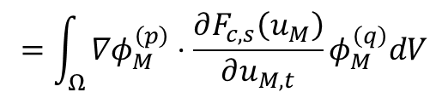
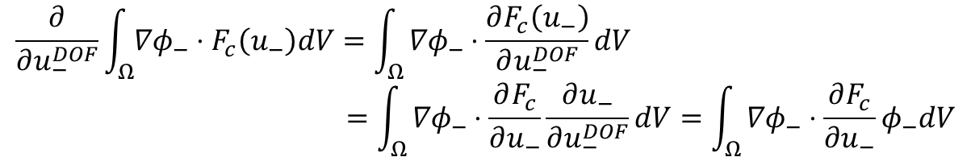


Formulation of Residual Terms
Convective Flux
Volume integral of owner cell
w.r.t. owner cell
w.r.t. neighbor cell
$$\frac{∂}{∂u_{−}^{DOF}}\int_{Ω}{{∇φ}_{−}⋅F_{c}\left(u_{−}\right)dV}=\int_{Ω}{{∇φ}_{−}⋅\frac{∂F_{c}\left(u_{−}\right)}{∂u_{−}^{DOF}}dV} \\ =\int_{Ω}{{∇φ}_{−}⋅\frac{∂F_{c}}{∂u_{−}}\frac{∂u_{−}}{∂u_{−}^{DOF}}dV=\int_{Ω}{{∇φ}_{−}⋅\frac{∂F_{c}}{∂u_{−}}φ_{−}dV}}$$
$$φ_{−}$$
$$=\int_{Ω}{{∇φ}_{M}^{\left(p\right)}⋅\frac{∂F_{c,s}\left(u_{M}\right)}{∂u_{M,t}}φ_{M}^{\left(q\right)}dV}$$
①
②
③
①
cell_coefficients [icell][ipoint][ibasis][idim]
$$\frac{∂}{∂u_{+}^{DOF}}\int_{Ω}{{∇φ}_{−}⋅F_{c}\left(u_{−}\right)dV}=0$$
②
conv_flux_owner_jacobian [ipoint][istate][jstate][idim]
③
cell_basis_value [icell][ipoint][jbasis]

Slide 18
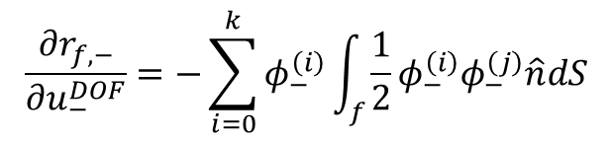

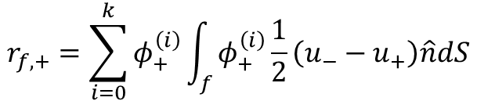
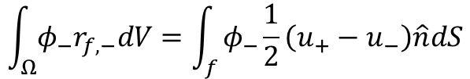
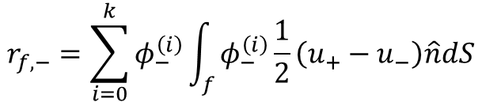
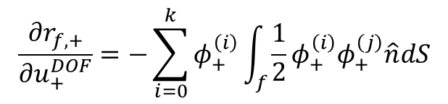
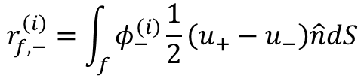
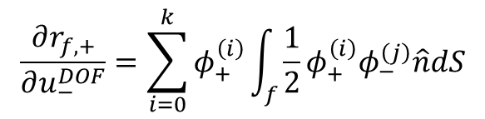

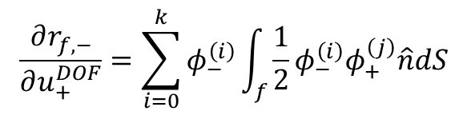
Formulation of Residual Terms
①
face_owner_to_owner_auxiliary_jacobian [iface][ipoint][jbasis][idim]
Viscous Flux
Jacobian of lifting operators
Local lifting operator
②
face_neighbor_to_owner_auxiliary_jacobian [iface][ipoint][jbasis][idim]
③
face_owner_to_neighbor_auxiliary_jacobian [iface][ipoint][jbasis][idim]
④
face_neighbor_to_neighbor_auxiliary_jacobian [iface][ipoint][jbasis][idim]
$$\int_{Ω}{φ_{−}r_{f,−}dV}=\int_{f}{φ_{−}\frac{1}{2}\left(u_{+}−u_{−}\right)\hat{n}dS}$$
$$r_{f,−}=\sum_{i=0}^{k}{φ_{−}^{\left(i\right)}r_{f,−}^{\left(i\right)}}$$
①
$$\frac{∂r_{f,−}}{∂u_{−}^{DOF}}=−\sum_{i=0}^{k}{φ_{−}^{\left(i\right)}\int_{f}{\frac{1}{2}φ_{−}^{\left(i\right)}φ_{−}^{\left(j\right)}\hat{n}dS}}$$
$$f∈∂Ω$$
$$r_{f,−}=\sum_{i=0}^{k}{φ_{−}^{\left(i\right)}}\int_{f}{φ_{−}^{\left(i\right)}\frac{1}{2}\left(u_{+}−u_{−}\right)\hat{n}dS}$$
②
$$\frac{∂r_{f,+}}{∂u_{−}^{DOF}}=\sum_{i=0}^{k}{φ_{+}^{\left(i\right)}\int_{f}{\frac{1}{2}φ_{+}^{\left(i\right)}φ_{−}^{\left(j\right)}\hat{n}dS}}$$
$$r_{f,−}^{\left(i\right)}=\int_{f}{φ_{−}^{\left(i\right)}\frac{1}{2}\left(u_{+}−u_{−}\right)\hat{n}dS}$$
$$r_{f,+}=\sum_{i=0}^{k}{φ_{+}^{\left(i\right)}}\int_{f}{φ_{+}^{\left(i\right)}\frac{1}{2}\left(u_{−}−u_{+}\right)\hat{n}dS}$$
③
$$\frac{∂r_{f,−}}{∂u_{+}^{DOF}}=\sum_{i=0}^{k}{φ_{−}^{\left(i\right)}\int_{f}{\frac{1}{2}φ_{−}^{\left(i\right)}φ_{+}^{\left(j\right)}\hat{n}dS}}$$
④
$$\frac{∂r_{f,+}}{∂u_{+}^{DOF}}=−\sum_{i=0}^{k}{φ_{+}^{\left(i\right)}\int_{f}{\frac{1}{2}φ_{+}^{\left(i\right)}φ_{+}^{\left(j\right)}\hat{n}dS}}$$

Slide 19

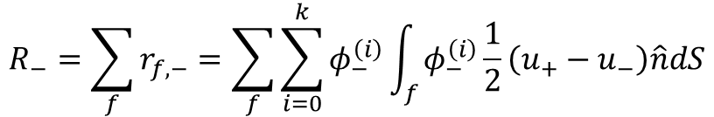

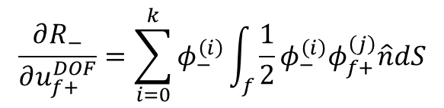
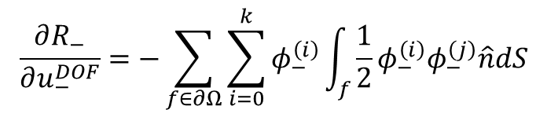
Formulation of Residual Terms
Viscous Flux
Jacobian of lifting operators
Global lifting operator
$$R_{−}=\sum_{f}{r_{f,−}=\sum_{f}{\sum_{i=0}^{k}{φ_{−}^{\left(i\right)}}\int_{f}{φ_{−}^{\left(i\right)}\frac{1}{2}\left(u_{+}−u_{−}\right)\hat{n}dS}}}$$
$$f∈∂Ω$$
$\hat{n}$ 포함
$$\frac{∂R_{−}}{∂u_{−}^{DOF}}=−\sum_{f∈∂Ω}{\sum_{i=0}^{k}{φ_{−}^{\left(i\right)}\int_{f}{\frac{1}{2}φ_{−}^{\left(i\right)}φ_{−}^{\left(j\right)}\hat{n}dS}}}$$
$$\frac{∂R_{−}}{∂u_{f+}^{DOF}}=\sum_{i=0}^{k}{φ_{−}^{\left(i\right)}\int_{f}{\frac{1}{2}φ_{−}^{\left(i\right)}φ_{f+}^{\left(j\right)}\hat{n}dS}}$$
①
②
①
cell_owner_to_owner_auxiliary_jacobian [owner_cell][ipoint][istate][jstate][ibasis][idim]
②
cell_owner_to_neighbor_auxiliary_jacobian [owner_cell][neighbor_cell][ipoint][ibasis][idim]

Slide 20


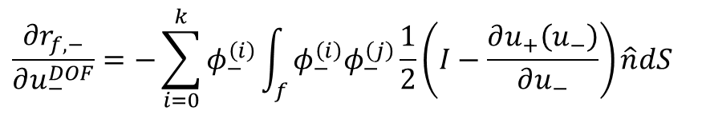
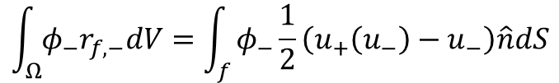
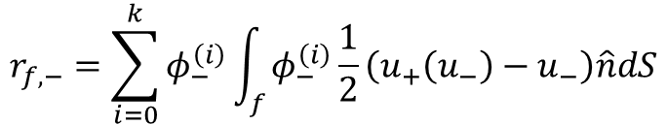
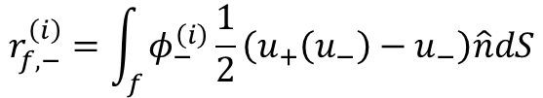

Formulation of Residual Terms
Viscous Flux(Boundary condition)
Jacobian of lifting operators
Local lifting operator
$\hat{n}$ 포함
$$\frac{∂r_{f,−}}{∂u_{−}^{DOF}}=−\sum_{i=0}^{k}{φ_{−}^{\left(i\right)}\int_{f}{φ_{−}^{\left(i\right)}φ_{−}^{\left(j\right)}\frac{1}{2}\left(I−\frac{∂u_{+}\left(u_{−}\right)}{∂u_{−}}\right)\hat{n}dS}}$$
$$\int_{Ω}{φ_{−}r_{f,−}dV}=\int_{f}{φ_{−}\frac{1}{2}\left(u_{+}\left(u_{−}\right)−u_{−}\right)\hat{n}dS}$$
$$r_{f,−}=\sum_{i=0}^{k}{φ_{−}^{\left(i\right)}r_{f,−}^{\left(i\right)}}$$
①
②
$$f∈∂Ω$$
①
bdry_auxiliary_jacobian_coefficients [ibdry][ipoint][ibasis][idim][jpoint]
②
solution_jacobian [ipoint][istate][jstate]
$$r_{f,−}^{\left(i\right)}=\int_{f}{φ_{−}^{\left(i\right)}\frac{1}{2}\left(u_{+}\left(u_{−}\right)−u_{−}\right)\hat{n}dS}$$
$$r_{f,−}=\sum_{i=0}^{k}{φ_{−}^{\left(i\right)}}\int_{f}{φ_{−}^{\left(i\right)}\frac{1}{2}\left(u_{+}\left(u_{−}\right)−u_{−}\right)\hat{n}dS}$$

Slide 21

Formulation of Residual Terms
Viscous Flux(Boundary condition)
Jacobian of lifting operators
Global lifting operator
bdry_cell_auxiliary_jacobian_coefficient [ibdry][ipoint][ibasis][idim][jpoint]
$$R_{−}=\sum_{f}{r_{f,−}=\sum_{f}{\sum_{i=0}^{k}{φ_{−}^{\left(i\right)}}\int_{f}{φ_{−}^{\left(i\right)}\frac{1}{2}\left(u_{+}−u_{−}\right)\hat{n}dS}}}$$
$$f∈∂Ω$$
$\hat{n}$ 포함
$$\frac{∂R_{−}}{∂u_{−}^{DOF}}=−\sum_{f∈∂Ω}{\sum_{i=0}^{k}{φ_{−}^{\left(i\right)}\int_{f}{φ_{−}^{\left(i\right)}φ_{−}^{\left(j\right)}\frac{1}{2}\left(I−\frac{∂u_{+}\left(u_{−}\right)}{∂u_{−}}\right)\hat{n}dS}}}$$
①
②
③
①
auxiliary_jacobian_ [owner_cell][ipoint][istate][jstate][ibasis][idim]
②
bdry_cell_auxiliary_jacobian_coefficients [ibdry][ipoint][ibasis][idim][ipoint]
③
solution_jacobian [ipoint][istate][jstate]

Slide 22





Formulation of Residual Terms
Viscous Flux
Face integral of owner cell
w.r.t. owner cell
$$\frac{∂}{∂u_{−}^{DOF}}\int_{∂Ω}{φ_{−}F_{v}^{∗}\left(u_{−},u_{+},∇u_{−}+r_{f,−},∇u_{+}+r_{f,+},\hat{n}\right)dS}=\int_{∂Ω}{φ_{−}\frac{∂F_{v}^{∗}}{∂u_{−}^{DOF}}dS} \\ =\int_{∂Ω}{φ_{−}\left[\frac{∂F_{v}^{∗}}{∂u_{−}}\frac{∂u_{−}}{∂u_{−}^{DOF}}+\frac{∂F_{v}^{∗}}{∂u_{+}}\frac{∂u_{+}}{∂u_{−}^{DOF}}\right]dS}$$
$$φ_{−}$$
$$0$$
$$+\int_{∂Ω}{φ_{−}\left[\frac{∂F_{v}^{∗}}{∂\left({∇u}_{−}+r_{f,−}\right)}⋅\left\{\frac{∂\left(∇u_{−}\right)}{∂u_{−}^{DOF}}+\frac{∂\left(r_{f,−}\right)}{∂u_{−}^{DOF}}\right\}+\frac{∂F_{v}^{∗}}{∂\left(∇u_{+}+r_{f,+}\right)}⋅\left\{\frac{∂\left(∇u_{+}\right)}{∂u_{−}^{DOF}}+\frac{∂\left(r_{f,+}\right)}{∂u_{−}^{DOF}}\right\}\right]dS}$$
$${∇φ}_{−}$$
$$0$$
$$=\int_{∂Ω}{φ_{M}^{\left(p\right)}\left[\frac{∂F_{v,s}^{∗}}{∂u_{M,t}}φ_{M}^{\left(q\right)}+\frac{∂F_{v,s}^{∗}}{∂{\left({∇u}_{M}+r_{f,M}\right)}_{t}}⋅\left\{∇φ_{M}^{\left(q\right)}+{\left(\frac{∂\left(r_{f,M}\right)}{∂u_{M}^{DOF}}\right)}^{\left(q\right)}\right\}+\frac{∂F_{v,s}^{∗}}{∂{\left(∇u_{N}+r_{f,N}\right)}_{t}}⋅{\left(\frac{∂\left(r_{f,N}\right)}{∂u_{M}^{DOF}}\right)}^{\left(q\right)}\right]dS}$$
①
②
③
④
⑤
⑥
⑦
⑧
①
face_owner_coefficients [iface][ipoint][ibasis]
⑤
face_owner_div_basis_value [iface][ipoint][ibasis][idim]
②
visc_flux_owner_jacobian [ipoint][istate][jstate]
⑥
face_owner_to_owner_auxiliary_jacobian [iface][ipoint][jbasis][idim]
③
face_owner_basis_value [iface][ipoint][jbasis]
⑦
visc_flux_neighbor_grad_jacobian [ipoint][istate][jstate][idim]
④
visc_flux_owner_grad_jacobian [ipoint][istate][jstate][idim]
⑧
face_neighbor_to_owner_auxiliary_jacobian [iface][ipoint][jbasis][idim]

Slide 23
Formulation of Residual Terms
Viscous Flux
Face integral of owner cell
w.r.t. neighbor cell
$$\frac{∂}{∂u_{+}^{DOF}}\int_{∂Ω}{φ_{−}F_{v}^{∗}\left(u_{−},u_{+},∇u_{−}+r_{f,−},∇u_{+}+r_{f,+},\hat{n}\right)dS}=\int_{∂Ω}{φ_{−}\frac{∂F_{v}^{∗}}{∂u_{+}^{DOF}}dS}$$
$$=\int_{∂Ω}{φ_{M}^{\left(p\right)}\left[\frac{∂F_{v,s}^{∗}}{∂u_{N,t}}φ_{N}^{\left(q\right)}\frac{∂F_{v,s}^{∗}}{∂{\left({∇u}_{M}+r_{f,M}\right)}_{t}}⋅{\left(\frac{∂\left(r_{f,M}\right)}{∂u_{N}^{DOF}}\right)}^{\left(q\right)}+\frac{∂F_{v,s}^{∗}}{∂{\left(∇u_{N}+r_{f,N}\right)}_{t}}⋅\left\{∇φ_{N}^{\left(q\right)}+{\left(\frac{∂\left(r_{f,N}\right)}{∂u_{N}^{DOF}}\right)}^{\left(q\right)}\right\}\right]dS}$$
①
②
③
④
⑤
⑥
⑦
⑧
①
face_owner_coefficients [iface][ipoint][ibasis]
⑤
face_owner_to_neighbor_auxiliary_jacobian [iface][ipoint][jbasis][idim]
②
visc_flux_neighbor_jacobian [ipoint][istate][jstate]
⑥
visc_flux_neighbor_grad_jacobian [ipoint][istate][jstate][idim]
③
face_neighbor_basis_value [iface][ipoint][ibasis][idim]
⑦
face_neighbor_div_basis_value [ipoint][istate][jstate]
④
visc_flux_owner_grad_jacobian [ipoint][istate][jstate][idim]
⑧
face_neighbor_to_neighbor_auxiliary_jacobian [iface][ipoint][jbasis][idim]

Slide 24





Formulation of Residual Terms
Viscous Flux
Face integral of neighbor
w.r.t. owner cell
$$−\frac{∂}{∂u_{−}^{DOF}}\int_{∂Ω}{φ_{+}F_{v}^{∗}\left(u_{−},u_{+},∇u_{−}+r_{f,−},∇u_{+}+r_{f,+},\hat{n}\right)dS}=−\int_{∂Ω}{φ_{+}\frac{∂F_{v}^{∗}}{∂u_{−}^{DOF}}dS} \\ =−\int_{∂Ω}{φ_{+}\left[\frac{∂F_{v}^{∗}}{∂u_{−}}\frac{∂u_{−}}{∂u_{−}^{DOF}}+\frac{∂F_{v}^{∗}}{∂u_{+}}\frac{∂u_{+}}{∂u_{−}^{DOF}}\right]dS}$$
$$φ_{−}$$
$$0$$
$$−\int_{∂Ω}{φ_{+}\left[\frac{∂F_{v}^{∗}}{∂\left({∇u}_{−}+r_{f,−}\right)}⋅\left\{\frac{∂\left(∇u_{−}\right)}{∂u_{−}^{DOF}}+\frac{∂\left(r_{f,−}\right)}{∂u_{−}^{DOF}}\right\}+\frac{∂F_{v}^{∗}}{∂\left(∇u_{+}+r_{f,+}\right)}⋅\left\{\frac{∂\left(∇u_{+}\right)}{∂u_{−}^{DOF}}+\frac{∂\left(r_{f,+}\right)}{∂u_{−}^{DOF}}\right\}\right]dS}$$
$${∇φ}_{−}$$
$$0$$
$$=−\int_{∂Ω}{φ_{N}^{\left(p\right)}\left[\frac{∂F_{v,s}^{∗}}{∂u_{M,t}}φ_{M}^{\left(q\right)}+\frac{∂F_{v,s}^{∗}}{∂{\left({∇u}_{M}+r_{f,M}\right)}_{t}}⋅\left\{∇φ_{M}^{\left(q\right)}+{\left(\frac{∂\left(r_{f,M}\right)}{∂u_{M}^{DOF}}\right)}^{\left(q\right)}\right\}+\frac{∂F_{v,s}^{∗}}{∂{\left(∇u_{N}+r_{f,N}\right)}_{t}}⋅{\left(\frac{∂\left(r_{f,N}\right)}{∂u_{M}^{DOF}}\right)}^{\left(q\right)}\right]dS}$$
①
②
③
④
⑤
⑥
⑦
⑧
①
face_neighbor_coefficients [iface][ipoint][ibasis]
⑤
face_owner_div_basis_value [iface][ipoint][ibasis][idim]
②
visc_flux_owner_jacobian [ipoint][istate][jstate]
⑥
face_owner_to_owner_auxiliary_jacobian [iface][ipoint][jbasis][idim]
③
face_owner_basis_value [iface][ipoint][jbasis]
⑦
visc_flux_neighbor_grad_jacobian [ipoint][istate][jstate][idim]
④
visc_flux_owner_grad_jacobian [ipoint][istate][jstate][idim]
⑧
face_neighbor_to_owner_auxiliary_jacobian [iface][ipoint][jbasis][idim]

Slide 25
Formulation of Residual Terms
Viscous Flux
Face integral of neighbor cell
w.r.t. neighbor cell
$$−\frac{∂}{∂u_{+}^{DOF}}\int_{∂Ω}{φ_{+}F_{v}^{∗}\left(u_{−},u_{+},∇u_{−}+r_{f,−},∇u_{+}+r_{f,+},\hat{n}\right)dS}=−\int_{∂Ω}{φ_{+}\frac{∂F_{v}^{∗}}{∂u_{+}^{DOF}}dS}$$
$$=−\int_{∂Ω}{φ_{N}^{\left(p\right)}[\frac{∂F_{v,s}^{∗}}{∂u_{N,t}}φ_{N}^{\left(q\right)}+\frac{∂F_{v,s}^{∗}}{∂{\left({∇u}_{M}+r_{f,M}\right)}_{t}}⋅{\left(\frac{∂\left(r_{f,M}\right)}{∂u_{N}^{DOF}}\right)}^{\left(q\right)}+\frac{∂F_{v,s}^{∗}}{∂{\left(∇u_{N}+r_{f,N}\right)}_{t}}⋅\left\{∇φ_{N}^{\left(q\right)}+{\left(\frac{∂\left(r_{f,N}\right)}{∂u_{N}^{DOF}}\right)}^{\left(q\right)}\right\}dS}$$
①
②
③
④
⑤
⑥
⑦
⑧
①
face_neighbor_coefficients [iface][ipoint][ibasis]
⑤
face_owner_to_neighbor_auxiliary_jacobian [iface][ipoint][jbasis][idim]
②
visc_flux_neighbor_jacobian [ipoint][istate][jstate]
⑥
visc_flux_neighbor_grad_jacobian [ipoint][istate][jstate][idim]
③
face_neighbor_basis_value [iface][ipoint][jbasis]
⑦
face_neighbor_div_basis_value [iface][ipoint][ibasis][idim]
④
visc_flux_owner_grad_jacobian [ipoint][istate][jstate][idim]
⑧
face_neighbor_to_neighbor_auxiliary_jacobian [iface][ipoint][jbasis][idim]

Slide 26




Formulation of Residual Terms
Viscous Flux
Volume integral of owner cell
w.r.t. owner cell
$$\frac{∂}{∂u_{−}^{DOF}}\int_{Ω}{∇φ_{−}⋅F_{v}\left(u_{−},∇u_{−}+R_{−}\right)dV}=\int_{Ω}{{∇φ}_{−}⋅\frac{∂F_{v}}{∂u_{−}^{DOF}}dV} \\ =\int_{Ω}{{∇φ}_{−}⋅\left[\frac{∂F_{v}}{∂u_{−}}\frac{∂u_{−}}{∂u_{−}^{DOF}}+\frac{∂F_{v}}{∂(∇u_{−}+R_{−})}⋅\left\{\frac{∂{∇u}_{−}}{∂u_{−}^{DOF}}+\frac{∂R_{−}}{∂u_{−}^{DOF}}\right\}\right]dS}$$
$$φ_{−}$$
$${∇φ}_{−}$$
$$=\int_{Ω}{∇φ_{M}^{\left(p\right)}⋅\left[\frac{∂F_{v,s}}{∂u_{M,t}}φ_{M}^{\left(q\right)}+\frac{∂F_{v,s}}{∂\left(∇u_{M}+R_{M}\right)}⋅\left\{∇φ_{M}^{\left(q\right)}+{\left(\frac{∂R_{M}}{∂u_{M}^{DOF}}\right)}^{\left(q\right)}\right\}\right]dS}$$
①
②
③
④
⑤
⑥
①
cell_coefficients [icell][ipoint][ibasis][idim]
⑤
cell_div_basis_value [icell][ipoint][ibasis][idim]
②
visc_flux_jacobian [ipoint][istate][jstate][idim]
⑥
cell_owner_to_owner_auxiliary_jacobian [icell][ipoint][ibasis][idim]
③
cell_basis_value [icell][ipoint][jbasis]
+ auxiliary_jacobian_ [icell][ipoint][istate][jstate][ibasis]
④
visc_flux_grad_jacobian [ipoint][istate][jstate][idim][jdim]

Slide 27




Formulation of Residual Terms
Viscous Flux
Volume integral of owner cell
w.r.t. neighbor cell
$$\frac{∂}{∂u_{+}^{DOF}}\int_{Ω}{∇φ_{−}⋅F_{v}\left(u_{−},∇u_{−}+R_{−}\right)dV}=\int_{Ω}{{∇φ}_{−}⋅\frac{∂F_{v}}{∂u_{+}^{DOF}}dV} \\ =\int_{Ω}{{∇φ}_{−}⋅\left[\frac{∂F_{v}}{∂u_{−}}\frac{∂u_{−}}{∂u_{+}^{DOF}}+\frac{∂F_{v}}{∂(∇u_{−}+R_{−})}⋅\left\{\frac{∂{∇u}_{−}}{∂u_{+}^{DOF}}+\frac{∂R_{−}}{∂u_{+}^{DOF}}\right\}\right]dS}$$
$$0$$
$$0$$
$$=\int_{Ω}{∇φ_{M}^{\left(p\right)}⋅\frac{∂F_{v,s}}{∂\left(∇u_{M}+R_{M}\right)}⋅{\left(\frac{∂R_{M}}{∂u_{N}^{DOF}}\right)}^{\left(q\right)}dS}$$
①
②
③
①
cell_coefficients [icell][ipoint][ibasis][idim]
②
visc_flux_jacobian [ipoint][istate][jstate][idim]
③
cell_owner_to_neighbor_auxiliary_jacobian [icell][ipoint][ibasis][idim]

Slide 28

Kronecker product

Slide 29






Formulation of Residual Terms
Using Kronecker product
Convective flux
Face integral of owner cell w.r.t. owner_cell
Face integral of owner cell w.r.t. neighbor_cell
Face integral of neighbor cell w.r.t. owner_cell
Face integral of neighbor cell w.r.t. neighbor_cell
Volume integral of owner cell w.r.t. owner_cell
Volume integral of neighbor cell w.r.t. neighbor_cell
$$\int_{∂Ω}{\frac{∂F_{c,s}^{∗}\left(u_{M},u_{N},\hat{n}\right)}{∂u_{M,t}}⨂\left(φ_{M}^{T}⨂φ_{M}\right)dS}$$
$$\int_{∂Ω}{\frac{∂F_{c,s}^{∗}\left(u_{M},u_{N},\hat{n}\right)}{∂u_{N,t}}⨂\left(φ_{N}^{T}⨂φ_{M}\right)dS}$$
$$−\int_{∂Ω}{\frac{∂F_{c,s}^{∗}\left(u_{M},u_{N},\hat{n}\right)}{∂u_{M,t}}⨂\left(φ_{M}^{T}⨂φ_{N}\right)dS}$$
$$−\int_{∂Ω}{\frac{∂F_{c,s}^{∗}\left(u_{M},u_{N},\hat{n}\right)}{∂u_{N,t}}⨂\left(φ_{N}^{T}⨂φ_{N}\right)dS}$$
$$−\int_{Ω}{\sum_{d}{\frac{∂F_{c,s}{\left(u_{M}\right)}^{d}}{∂u_{M,t}}⨂\left(φ_{M}^{T}⨂\frac{∂φ_{M}}{∂x_{d}}\right)}dS}$$
$$=0$$

Slide 30



Formulation of Residual Terms
For boundary
$$\frac{∂r_{f,−}}{∂u_{−}^{DOF}}=−\left(I⨂φ_{M}^{T}\right)\int_{f}{\frac{n^{d}}{2}\left(I−\frac{∂u_{N}\left(u_{M}\right)}{∂u_{M}}\right)⨂\left(φ_{M}^{T}⨂φ_{M}\right)dA}$$
Using Kronecker product
Viscous flux
Face integral of owner cell w.r.t. owner_cell
Face integral of owner cell w.r.t. neighbor_cell
$$=\int_{∂Ω}{\left[\frac{∂F_{v,s}^{∗}}{∂u_{M,t}}⨂φ_{M}^{T}+\frac{∂F_{v,s}^{∗}}{∂{\left({∇u}_{M}+r_{f,M}\right)}_{t,d}}\left\{\left(I⨂{\left(\frac{∂φ_{M}}{∂x^{d}}\right)}^{T}\right)−\left(I⨂φ_{M}^{T}\right)\int_{f}{\frac{n^{d}}{2}I⨂\left(φ_{M}^{T}⨂φ_{M}\right)dA}\right\}+\frac{∂F_{v,s}^{∗}}{∂{\left(∇u_{N}+r_{f,N}\right)}_{t,d}}\left(I⨂φ_{N}^{T}\right)\int_{f}{\frac{n^{d}}{2}I⨂\left(φ_{M}^{T}⨂φ_{N}\right)dA}\right]⨂φ_{M}dS}$$
$$=\int_{∂Ω}{\left[\frac{∂F_{v,s}^{∗}}{∂u_{N,t}}⨂φ_{N}^{T}+\frac{∂F_{v,s}^{∗}}{∂{\left({∇u}_{M}+r_{f,M}\right)}_{t,d}}\left(I⨂φ_{M}^{T}\right)\int_{f}{\frac{n^{d}}{2}I⨂\left(φ_{N}^{T}⨂φ_{M}\right)dA}+\frac{∂F_{v,s}^{∗}}{∂{\left(∇u_{N}+r_{f,N}\right)}_{t,d}}\left\{\left(I⨂{\left(\frac{∂φ_{N}}{∂x^{d}}\right)}^{T}\right)−\left(I⨂φ_{N}^{T}\right)\int_{f}{\frac{n^{d}}{2}I⨂\left(φ_{N}^{T}⨂φ_{N}\right)dA}\right\}\right]⨂φ_{M}dS}$$

Slide 31


Formulation of Residual Terms
Using Kronecker product
Viscous flux
Face integral of neighbor cell w.r.t. owner_cell
Face integral of neighbor cell w.r.t. neighbor_cell
$$=−\int_{∂Ω}{\left[\frac{∂F_{v,s}^{∗}}{∂u_{M,t}}⨂φ_{M}^{T}+\frac{∂F_{v,s}^{∗}}{∂{\left({∇u}_{M}+r_{f,M}\right)}_{t,d}}\left\{\left(I⨂{\left(\frac{∂φ_{M}}{∂x^{d}}\right)}^{T}\right)−\left(I⨂φ_{M}^{T}\right)\int_{f}{\frac{n^{d}}{2}I⨂\left(φ_{M}^{T}⨂φ_{M}\right)dA}\right\}+\frac{∂F_{v,s}^{∗}}{∂{\left(∇u_{N}+r_{f,N}\right)}_{t,d}}\left(I⨂φ_{N}^{T}\right)\int_{f}{\frac{n^{d}}{2}I⨂\left(φ_{M}^{T}⨂φ_{N}\right)dA}\right]⨂φ_{N}dS}$$
$$=−\int_{∂Ω}{\left[\frac{∂F_{v,s}^{∗}}{∂u_{N,t}}⨂φ_{N}^{T}+\frac{∂F_{v,s}^{∗}}{∂{\left({∇u}_{M}+r_{f,M}\right)}_{t,d}}\left(I⨂φ_{M}^{T}\right)\int_{f}{\frac{n^{d}}{2}I⨂\left(φ_{N}^{T}⨂φ_{M}\right)dA}+\frac{∂F_{v,s}^{∗}}{∂{\left(∇u_{N}+r_{f,N}\right)}_{t,d}}\left\{\left(I⨂{\left(\frac{∂φ_{N}}{∂x^{d}}\right)}^{T}\right)−\left(I⨂φ_{N}^{T}\right)\int_{f}{\frac{n^{d}}{2}I⨂\left(φ_{N}^{T}⨂φ_{N}\right)dA}\right\}\right]⨂φ_{N}dS}$$

Slide 32


Formulation of Residual Terms
For boundary
Using Kronecker product
Viscous flux
Volume integral of owner cell w.r.t. owner_cell
Volume integral of owner cell w.r.t. neighbor_cell
$$\frac{∂R_{−}}{∂u_{−}^{DOF}}=−\sum_{f∈∂Ω}{\left(I⨂φ_{M}^{T}\right)\int_{f}{\frac{n^{d}}{2}\left(I−\frac{∂u_{N_{f}}\left(u_{M}\right)}{∂u_{M}}\right)⨂\left(φ_{M}^{T}⨂φ_{M}\right)dA}}$$
$$=\int_{∂Ω}{\sum_{d}{\left[\frac{∂F_{v,s}^{d}}{∂u_{M,t}}⨂φ_{M}^{T}+\frac{∂F_{v,s}^{d}}{∂{\left(∇u_{M}+R_{M}\right)}_{t,d^{′}}}⨂\left\{{\left(\frac{∂φ}{∂x^{d^{′}}}\right)}^{T}−\sum_{f∈∂Ω}{\left(I⨂φ_{M}^{T}\right)\int_{f}{\frac{n^{d^{′}}}{2}I⨂\left(φ_{M}^{T}⨂φ_{M}\right)dA}}\right\}\right]⨂\frac{∂φ_{M}}{∂x^{d}}}dV}$$
$$=\int_{∂Ω}{\sum_{d}{\left[\frac{∂F_{v,s}^{d}}{∂{\left(∇u_{M}+R_{M}\right)}_{t,d^{′}}}⨂\left\{\sum_{f∈∂Ω}{\left(I⨂φ_{N_{f}}^{T}\right)\int_{f}{\frac{n^{d^{′}}}{2}I⨂\left(φ_{M}^{T}⨂φ_{N_{f}}\right)dA}}\right\}\right]⨂\frac{∂φ_{M}}{∂x^{d}}}dV}$$

Slide 33
PETSc Manual
Starting PETSc
PetscInitialize(int *argc, char ***argv, char *file, char *help)
Initialize PETSc and MPI
Automatically calls MPI_Init() if MPI has not been not previously initialized.
PetscFinalize()

Slide 34
PETSc Manual
Vector operation(mandatory)
VecCreate(MPI_Comm comm, Vec *v)
VecSetSizes(Vec v, PetscInt m, PetscInt M)
M: Total size, m: local size
VecSetFromOptions(Vec v)
VecSet(Vec x, PetscScalar value)
VecSetValues(Vec x, PetscInt n, PetscInt *indices, PetscScalar *values, INSERT_VALUES)
INSERT_VALUES/ADD_VALUES
n: the number of components to insert/add
VecAssemblyBegin(Vec x)
VecAssemblyEnd(Vec x)
VecDestroy(Vec *x)

Slide 35
PETSc Manual
Vector operation(optional)
VecView(Vec x, PetscViewer v)
v = PETSC_VIEWER_STDOUT_WORLD
VecDuplicate(Vec old, Vec *new)
VecGetOwnershipRange(Vec vec, PetscInt *low, PetscInt *high)
Return a process’s local range
VecGetArray(Vec v, PetscScalar **array), VecRestoreArray(Vec v, PetscScalar **array)
VecGetArrayRead(Vec v, const PetscScalar **array) VecRestoreArrayRead(Vec v, const PetscScalar **array)
VecGetLocalSize(Vec v, PetscInt *size)
VecGetSize(Vec v, PetscInt *size)

Slide 36

PETSc Manual
Vector operation(optional)

Slide 37
PETSc Manual
Matrix operation(mandatory)
MatCreate(MPI_Comm comm, Vec *v)
MatSetSizes(Mat A, PetscInt m, PetscInt n, PetscInt M, PetscInt N)
m,n: local matrix dimension
M,N: global matrix dimension
If you assign local dimension, use PETSC_DECIDE for global dimension.
MatSetValues(Mat A, PetscInt m, const PetscInt idxm[], PetscInt n, const PetscInt idxn[], const PetscScalar values[], INSERT_VALUES)
Inserts or adds a logically dense subblock of dimension m*n
idxm,idxn: global row and column numbers
INSERT_VALUES/ADD_VALUES
MatAssemblyBegin(Mat A, MAT_FINAL_ASSEMBLY) MatAssemblyEnd(Mat A, MAT_FINAL_ASSEMBLY)

Slide 38
PETSc Manual
Matrix operation(mandatory)
MatSeqAIJSetPreallocation(Mat mat, PetscInt nz, const PetscInt nnz[])
nz: number of nonzeros per row (same for all rows)
nnz: array containing the number of nonzeros in the various rows or NULL(if nnz is given, nz is ignored)
MatMPIAIJSetPreallocation(Mat mat, PetscInt d_nz, const PetscInt d_nnz[], PetscInt o_nz, const PetscInt o_nnz[])
d_nz: number of nonzeros per row in DIAGONAL portion of local submatrix(same value is used for all local rows)
d_nnz: array containing the number of nonzeros in the various rows of the DIAGONAL portion of the local submatrix or NULL. The size of this array is equal to the number of local rows
o_nz: number of nonzeros per row in the OFF-DIAGONAL portion of local submatrix (same value is used for all local rows)
o_nnz: array containing the number of nonzeros in the various rows of the OFF-DIAGONAL portion of the local submatrix (possibly different for each row) or NULL. The size of this array is equal to the number of local rows.
MatDestroy(Mat *mat)

Slide 39



PETSc Manual
Matrix operation(mandatory)
MatSeqAIJSetPreallocation(Mat mat, PetscInt nz, const PetscInt nnz[])
MatMPIAIJSetPreallocation(Mat mat, PetscInt d_nz, const PetscInt d_nnz[], PetscInt o_nz, const PetscInt o_nnz[])
Example

Slide 40

PETSc Manual
Matrix operation(optional)
MatGetOwnershipRange(Mat A, PetscInt *first_row, PetscInt *last_row)
All rows from (first_row) to (last_row – 1) will be stored on the local process.
MatView(Mat mat, PETSC_VIEWER_STDOUT_WORLD)

Slide 41
PETSc Manual
KSP: Linear System Solvers
KSPCreate(MPI_Comm comm, KSP *ksp)
KSPSetFromOptions(KSP ksp)
KSPSetType(KSP ksp, KSPType type)
KSPSetInitialGuessNonzero(KSP ksp, PetscBool flg)
PETSC_TRUE/PETSC_FALSE
KSPGMRESSetRestart(KSP ksp, PetscInt restart)
KSPGMRESSetOrthogonalization(KSP ksp, PetscErrorCode (*fcn)(KSP, PetscInt)
KSPGMRESModifiedGramSchmidtOrthogonalization
KSPGetPC(KSP ksp, PC *pc)
KSPSetPCSide(KSP ksp, PCSide side)
PC_LEFT/PC_RIGHT/PC_SYMMETRIC
PCSetType(PC pc, PCType type)
KSPSetTolerance(KSP ksp, PetscReal rtol, PetscReal abstol, PetscReal dtol, PetscInt maxits)
KSPSetOperators(KSP ksp, Mat Amat, Mat Pmat)
KSPSolve(KSP ksp, Vec b, Vec x)
KSPGetIterationNumber(KSP ksp, PetscInt *its)
Returns iteration - 1

Slide 42
Code 요구사항
Grid가 viscous해석인지 inviscid 해석인지 알 수 있었으면 좋겠다.
Time step을 결정하는 것은 Time 또는 TimeScheme에서 하는 것이 좋겠다.
Zone보다는 Time이 다 컨트롤 했으면 좋겠음
주석을 다 다는 것이 좋겠다.
PETSc에서 바로 계산 가능한 함수들.
Ex. Zone 함수, limiter 함수
원하는 문자열 덧붙여 출력
직관적인 iteration 횟수 + 초기 조건 출력
Order test를 위한 exact solution

